Slide 1
Infrastructure Testing and Validation (Networking, Compute, Storage)
Presented by KV Prem Kumar

Slide 2
AGENDA
VPC Setup : VPC, Public and Private Subnets, Internet Gateway, Public and Private Route Tables using Terraform.
EC2 Instance : Public and Private Instance with VPC and subnets using Terraform and Verify the internet Gateway Communication.
S3 Bucket : S3 Bucket with Public and Private Access by generating Bucket Policy using Terraform.
IAM User : IAM User with S3FullAccess and Verify the Public and Private Access in S3 Bucket.

Slide 3
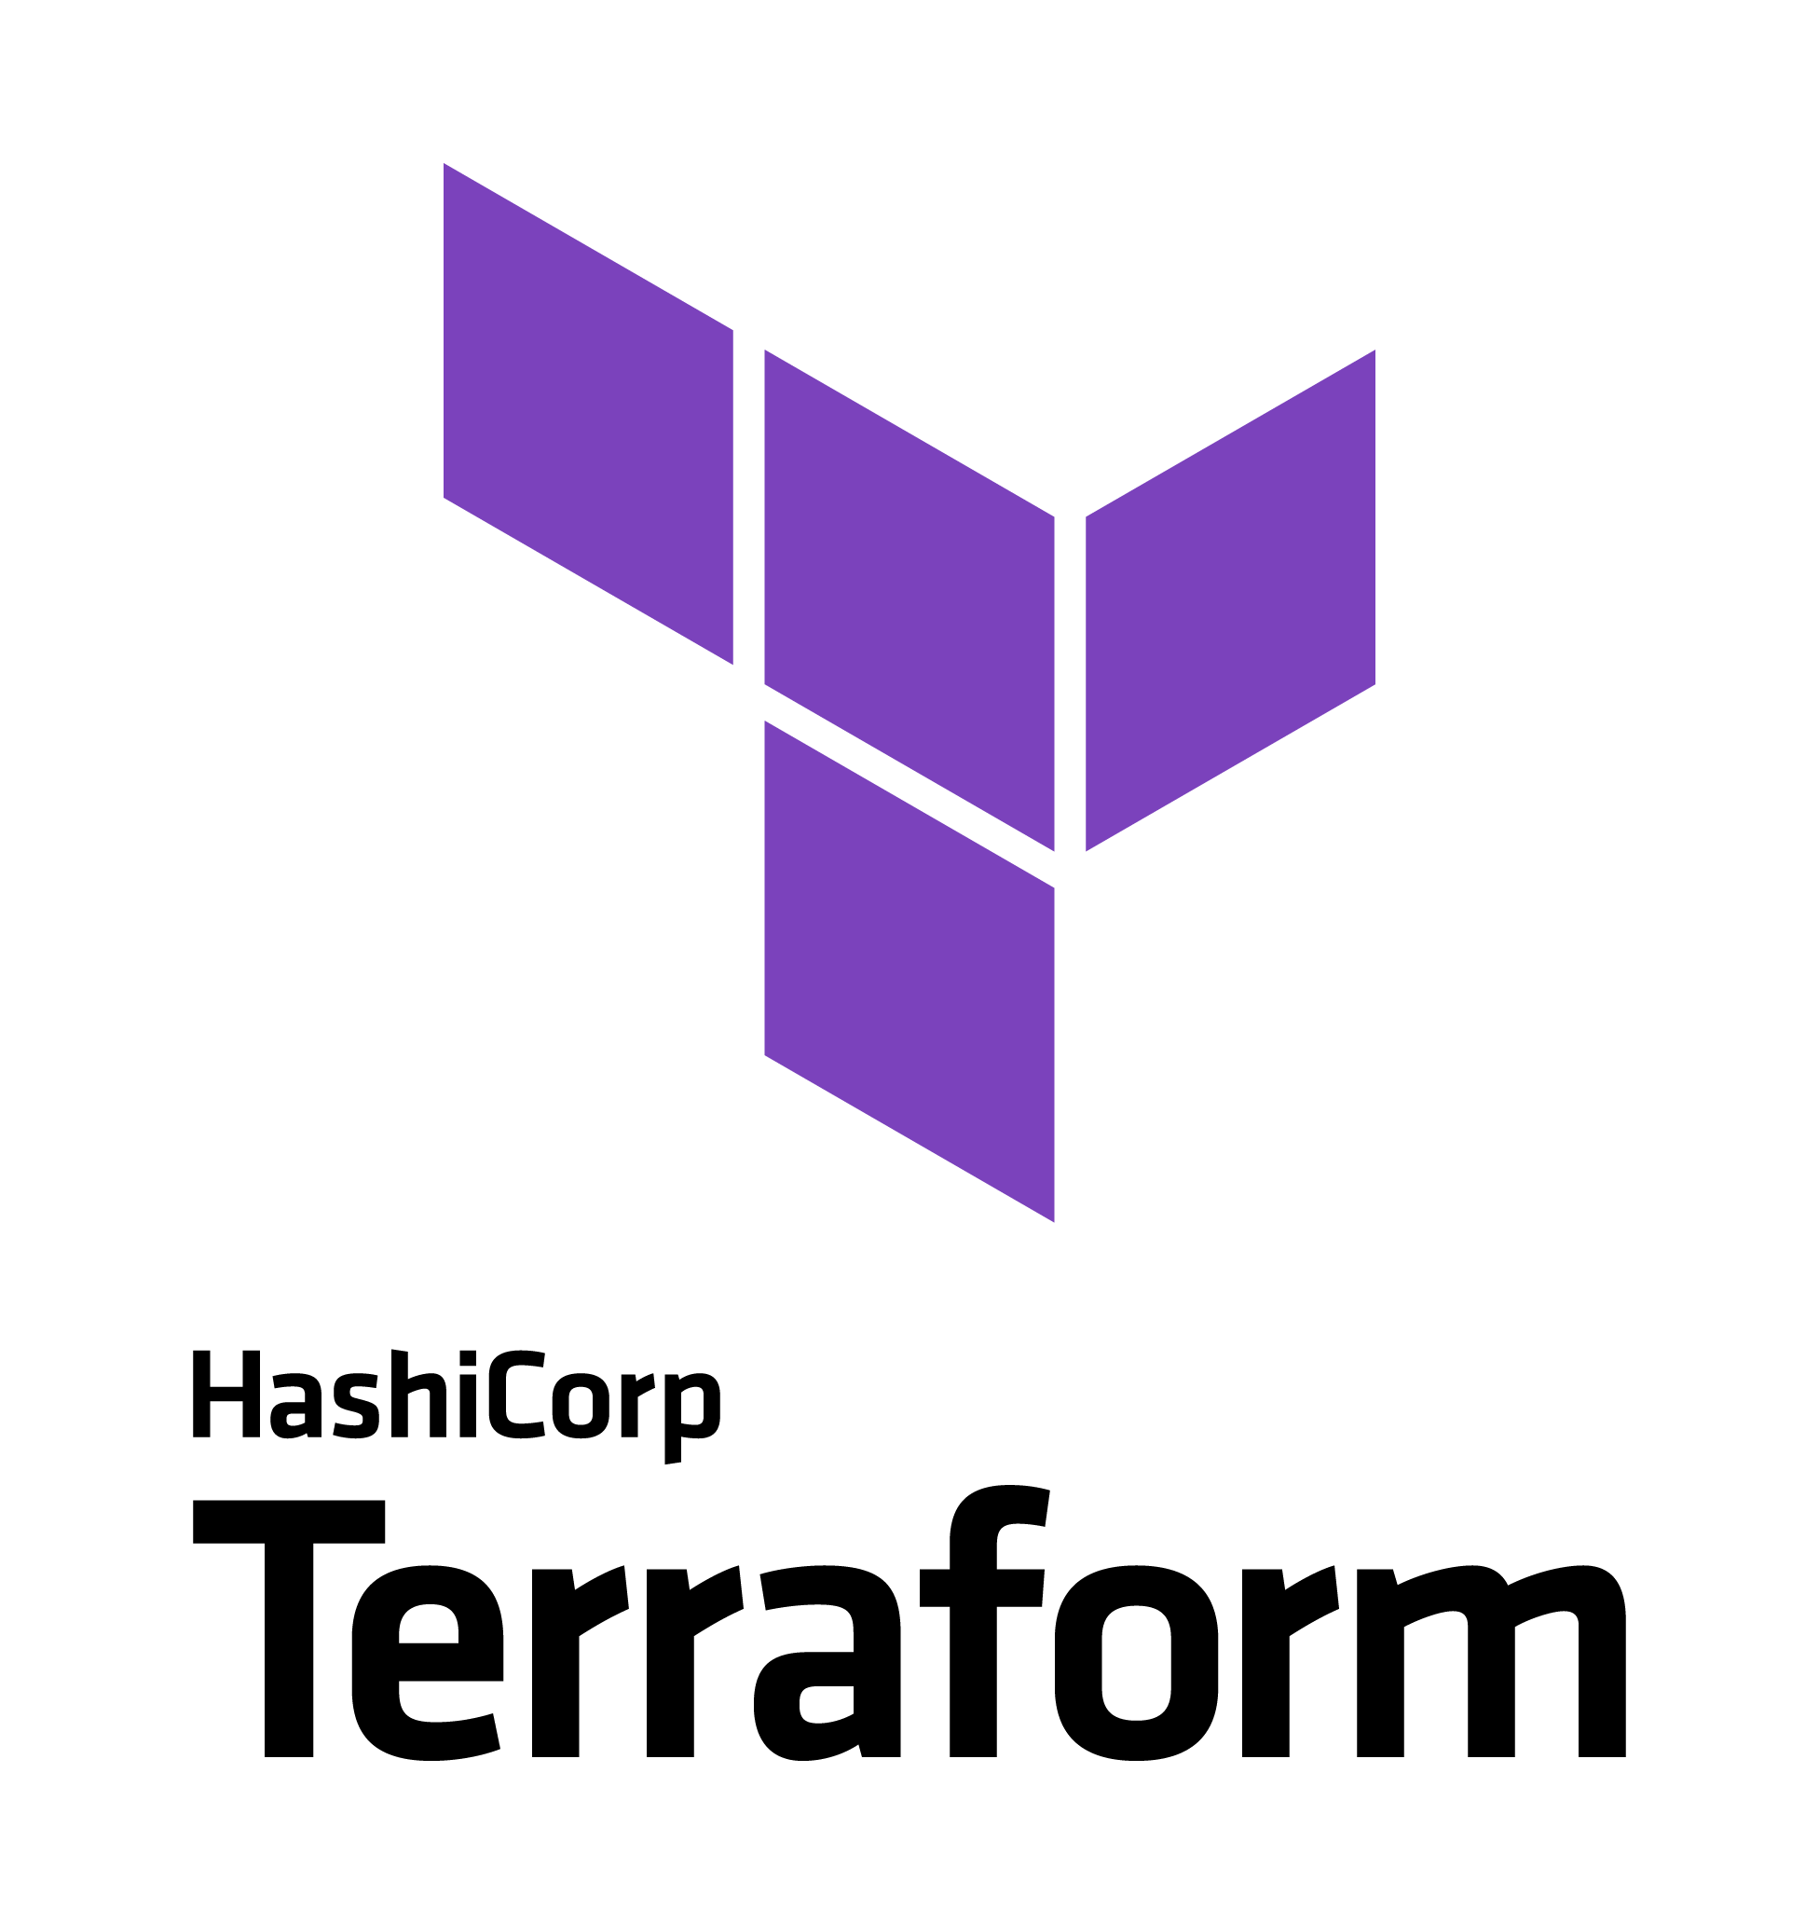
Introduction
Terraform:​
Terraform is an open-source Infrastructure as Code (IaC) tool that allows you to provision and manage infrastructure using declarative configuration files. Using Terraform, you can create, update, and manage AWS resources such as Virtual Private Clouds (VPCs), EC2 instances, subnets, route tables, and more.
In this guide, we will walk through how to use Terraform to create a VPC, including subnets, Internet Gateway, and EC2 instances.

Slide 4
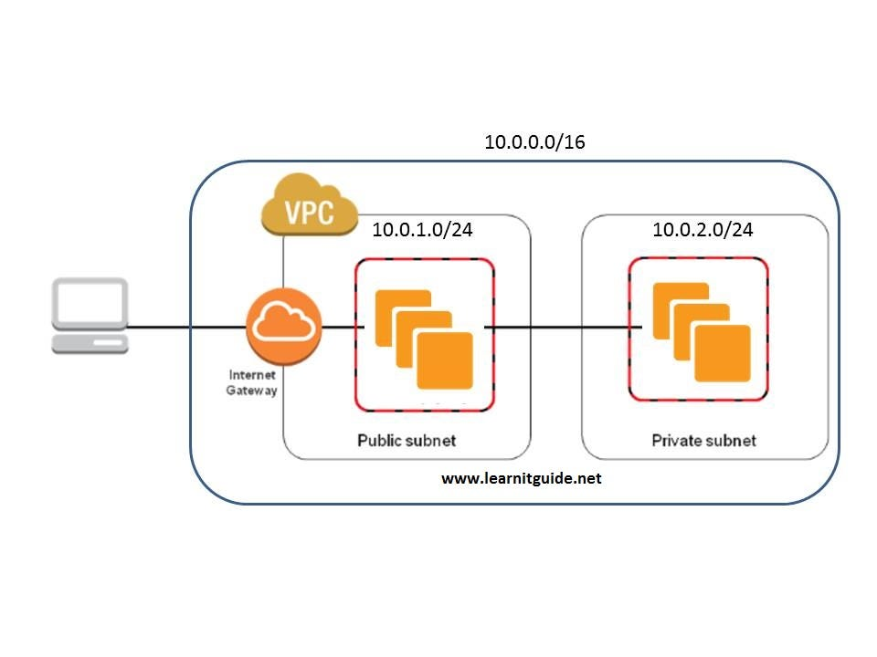
Virtual Private Cloud (VPC)
A Virtual Private Cloud (VPC) is a private network in the cloud that allows you to securely run your applications and store your data. It is like a private data center in the cloud, where you can control your network settings, such as IP address ranges, subnets, and routing.
key concepts related to VPC networking:
Subnets:
A VPC is divided into multiple subnets, which are segments of the VPC's IP address range. Subnets are usually created based on availability zones, which are isolated data centers within a region.

Slide 5
Subnets can be classified as:
Public Subnets: Can communicate directly with the internet via a route to an internet gateway.
Private Subnets: Do not have direct internet access; they communicate with the internet via a NAT gateway or instance.
Internet Gateway (IGW):
An Internet Gateway is a VPC component that allows communication between instances in the VPC and the internet. It is necessary for routing traffic to and from the internet, typically used by resources in public subnets.
Route Tables:
A route table controls the traffic routing within a VPC. It defines which network traffic is allowed to go between subnets, to/from the internet, or to/from a VPN connection.
You can create custom route tables and associate them with specific subnets.

Slide 6
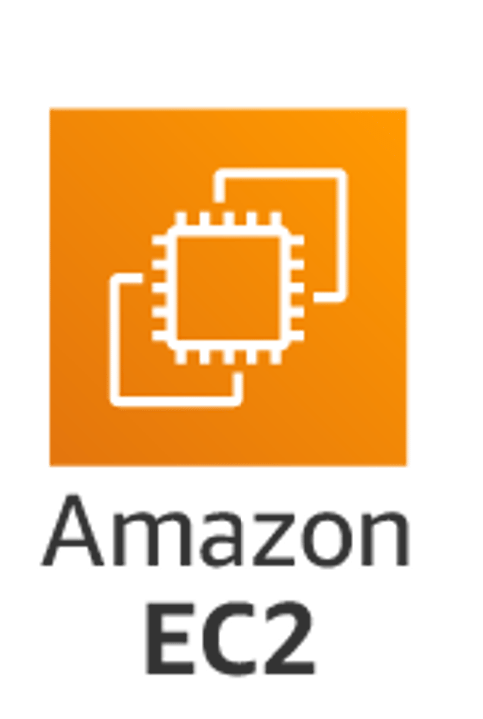
Elastic Compute Cloud (EC2)
Amazon EC2 (Elastic Compute Cloud) is a service provided by Amazon Web Services (AWS) that allows you to rent virtual servers (known as instances) in the cloud. These instances can run a variety of operating systems, and they can be used to run applications, host websites, process data, and much more. EC2 gives you complete control over your virtual machines (VMs) and their resources.
In simple terms, an EC2 instance is like a virtual computer in the cloud that you can use to run your workloads.

Slide 7
Code Description and Explanation:
provider "aws" {
region = "ap-south-1"
}
resource "aws_vpc" "myvpc" {
cidr_block = "10.0.0.0/16"
tags = {
Name = "vpc01"
}
}
resource "aws_subnet" "public_subnet" {
vpc_id = aws_vpc.myvpc.id
cidr_block = "10.0.1.0/24"
availability_zone = "ap-south-1a"
tags = {
Name = "Publicsubnet"
}
}
This Terraform code is designed to provision resources in AWS using the ap-south-1 (Mumbai) region. It includes VPC (Virtual Private Cloud), an EC2 instance setup, and security configurations.
Below is an explanation of the code components:​
1. AWS Provider Configuration​:
Configures the AWS provider for the ap-south-1 region (Mumbai).​
2. Create VPC, Subnets, Internet Gateway and Route
Tables:
Create VPC with CIDR Block for IP Addressing
Create Public Subnet and Private Subnet with VPC ID, CIDR Block and Availability Zone.

Slide 8
Create Internet Gateway for internet connection to communicate.
Create Public Route Table and connect route to the Internet Gateway.
Create Route Table Association and attach Public Subnet.
resource "aws_subnet" "private_subnet" {
vpc_id = aws_vpc.myvpc.id
cidr_block = "10.0.2.0/24"
availability_zone = "ap-south-1b"
tags = {
Name = "Privatesubnet"
}
}
resource "aws_internet_gateway" "myigw" {
vpc_id = aws_vpc.myvpc.id
tags = {
Name = "igw1"
}
}
resource "aws_route_table" "public_rt" {
vpc_id = aws_vpc.myvpc.id
route {
cidr_block = "0.0.0.0/0"
gateway_id = aws_internet_gateway.myigw.id
}
tags = {
Name = "PublicRT"
}
}
resource "aws_route_table_association" "public_rta" {
subnet_id = aws_subnet.public_subnet.id
route_table_id = aws_route_table.public_rt.id
}

Slide 9
Create Private Route Table .
Create Route Table Association and attach Private Subnet.
resource "aws_route_table" "private_rt" {
vpc_id = aws_vpc.myvpc.id
tags = {
Name = "PrivateRT"
}
}
resource "aws_route_table_association" "private_rta" {
subnet_id = aws_subnet.private_subnet.id
route_table_id = aws_route_table.private_rt.id
}

Slide 10
3. Create Security Group
Configures inbound and outbound traffic rules for the EC2 instance to ensure secure connectivity.
Ingress Rules:
Port 22 (SSH): Allows remote server access.
Egress Rules:
Allows unrestricted outbound traffic for internet communication.
resource "aws_security_group" "vpc_sg" {
vpc_id = aws_vpc.myvpc.id
ingress {
from_port = 22
to_port = 22
protocol = "tcp"
cidr_blocks = ["0.0.0.0/0"]
}
egress {
from_port = 0
to_port = 0
protocol = "-1"
cidr_blocks = ["0.0.0.0/0"]
}
tags = {
Name = "VpcSG"
}
}

Slide 11
4. EC2 Instance Configuration
Create Public instance with name PublicEC2
AMI: Amazon Linux 2023.
Instance Type: t2.micro
Key Pair: keypair1 enables secure SSH access.​
Subnet: Launches in the Public subnet of ap-south-1a.​
Security Group: Uses vpc_sg to manage inbound and ​outbound traffic.​
resource "aws_instance" "public_instance" {
ami = "ami-0fd05997b4dff7aac"
instance_type = "t2.micro"
key_name = "keypair1"
vpc_security_group_ids = [aws_security_group.vpc_sg.id]
subnet_id = aws_subnet.public_subnet.id
depends_on = [ aws_vpc.myvpc ]
tags = {
Name= "PublicEC2"
}
}

Slide 12
Create Private instance with name PrivateEC2
AMI: Amazon Linux 2023.
Instance Type: t2.micro
Key Pair: keypair1 enables secure SSH access.​
Subnet: Launches in the Private subnet of ap-south-1a.​
Security Group: Uses vpc_sg to manage inbound and ​outbound traffic.​
resource "aws_instance" "private_instance" {
ami = "ami-0fd05997b4dff7aac"
instance_type = "t2.micro"
key_name = "keypair1"
vpc_security_group_ids = [aws_security_group.vpc_sg.id]
subnet_id = aws_subnet.private_subnet.id
depends_on = [ aws_vpc.myvpc ]
tags = {
Name= "PrivateEC2"
}
}

Slide 13
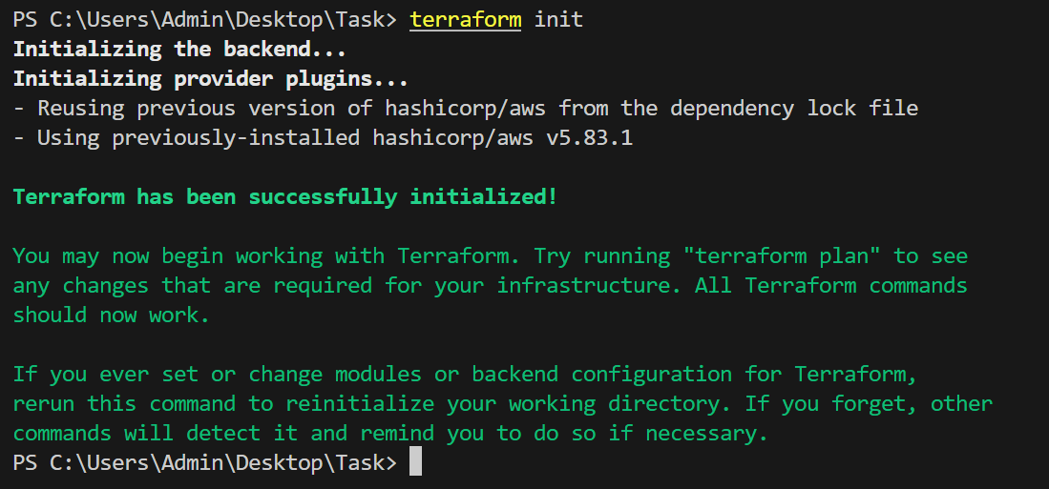
Steps to Initialize, Plan and Apply Terraform
Initialize Terraform:
Run terraform init to:
Run terraform init to Download and configure the necessary provider plugins.
Prepare the working directory for Terraform usage.
Ensure the backend configuration (if defined) is initialized.

Slide 14
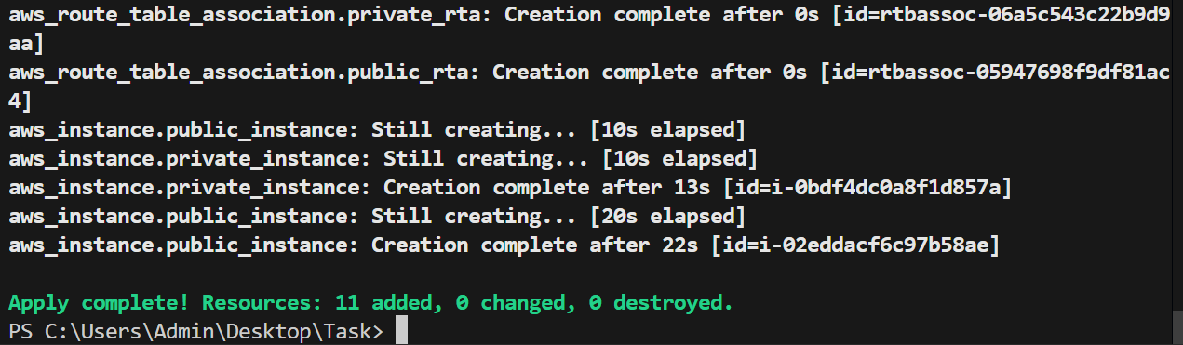
Plan Terraform Execution:
After terraform init, we use terraform plan to check the preview changes that made in infrastructure.
Ensure the configurations are correct before applying changes.​
Apply Terraform Configuration​
Execute terraform apply to:​
Provision and configure resources as defined in your Terraform files.​
Review and confirm the changes if prompted.​

Slide 15
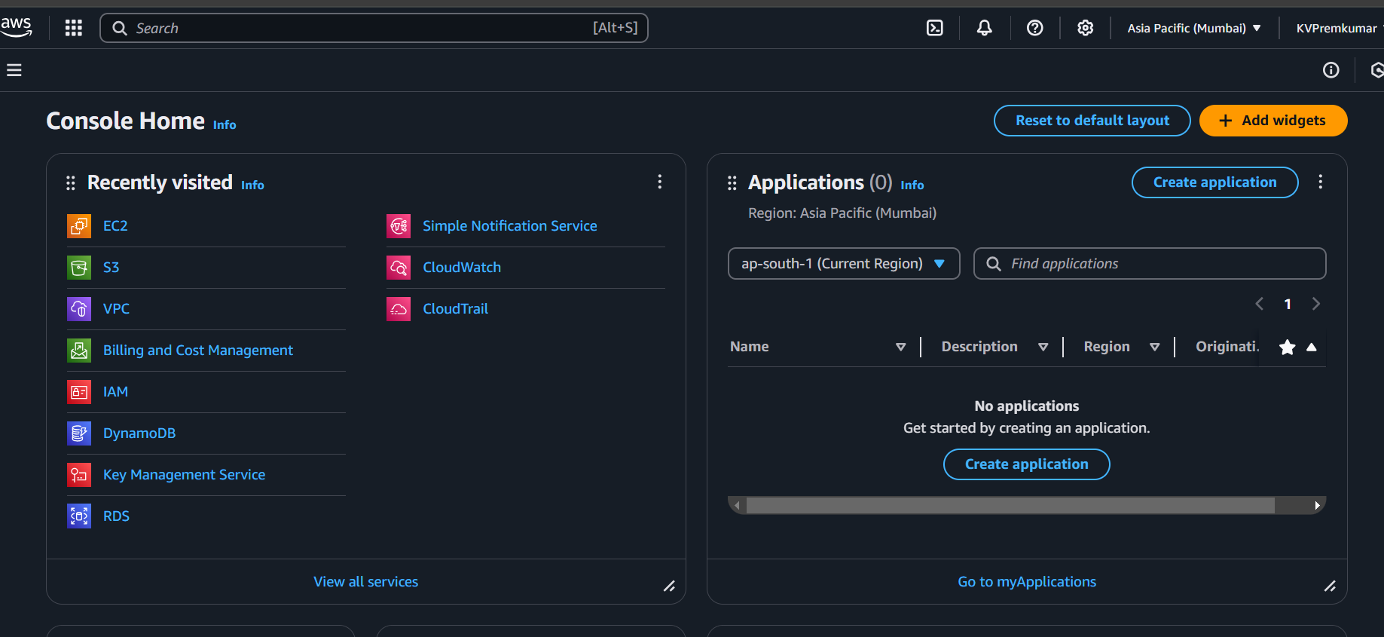
Verification steps in AWS Management Consol
Open the AWS Console and open the VPC and EC2 Instance for verification

Slide 16
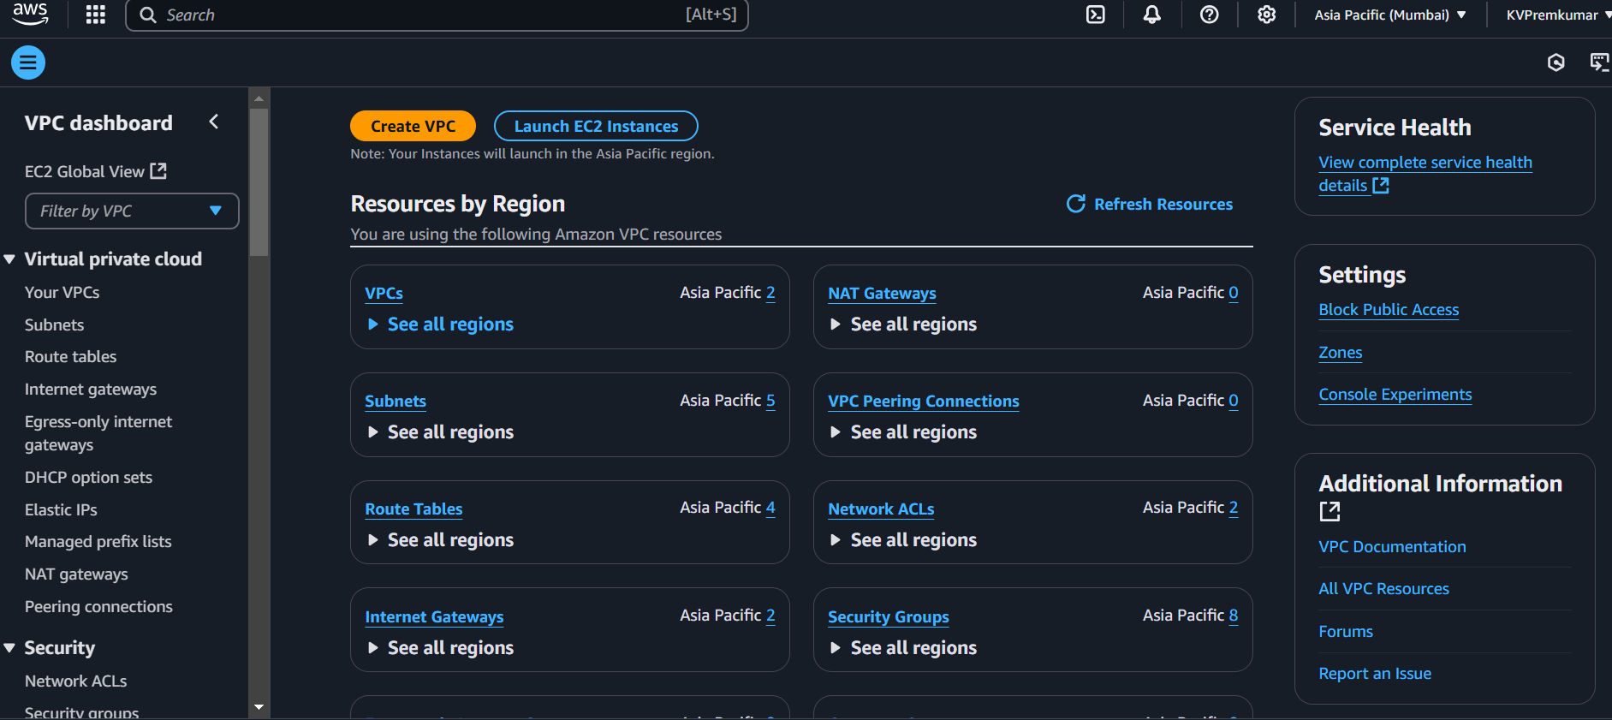
Verify VPC Configurations
Open VPC Resource and check the VPC, Subnet, Internet Gateway and Route Tables​.
Go to VPC and check the new vpc is created.

Slide 17
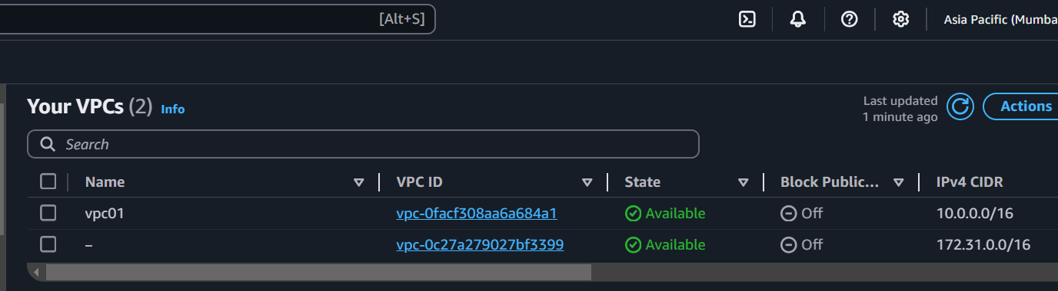
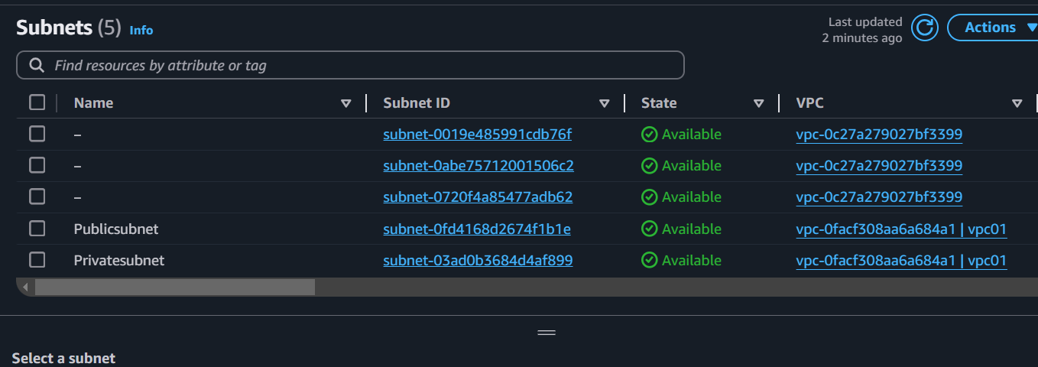
Check VPC
Click on VPC and check the vpc01 with the IP Address 10.0.0.0/16 .
Check Subnets
Click on Subnet and check the Publicsubnet and Privatesubnet are created in vpc01.

Slide 18
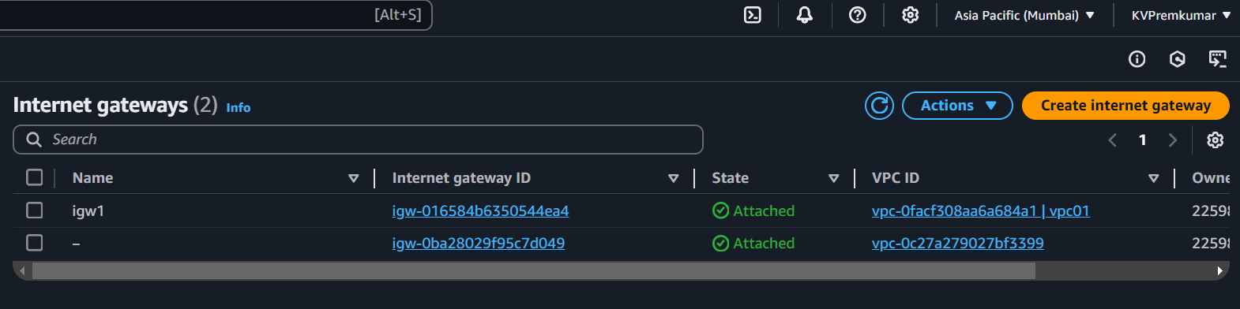
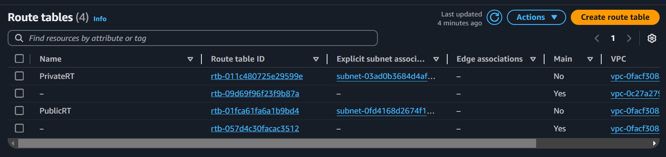
Check Internet Gateway
Click on Internet Gateway and check the igw1 is created in vpc01.
Check Route Tables
Click on Route Tables and check the igw1 is created in vpc01.

Slide 19
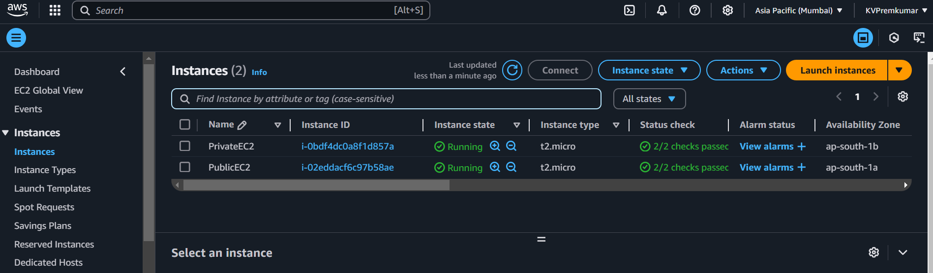
Check EC2 Instance
Click on Internet Gateway and check the igw1 is created in vpc01.

Slide 20
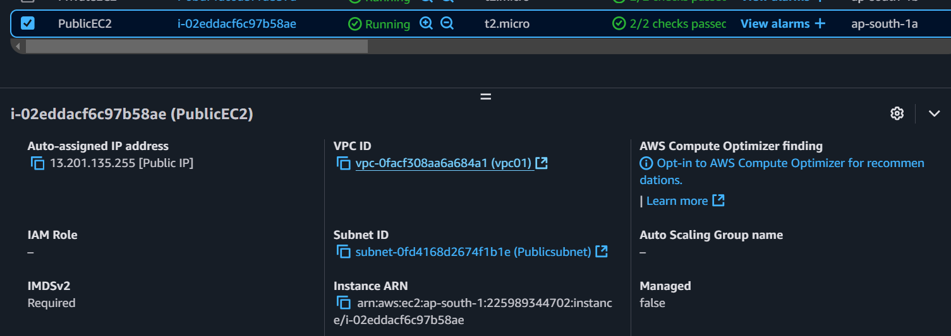
Verify EC2 Configurations
Open EC2 Resource and check the PublicEC2 is connected to the created vpc01 and Publicsubnet.

Slide 21
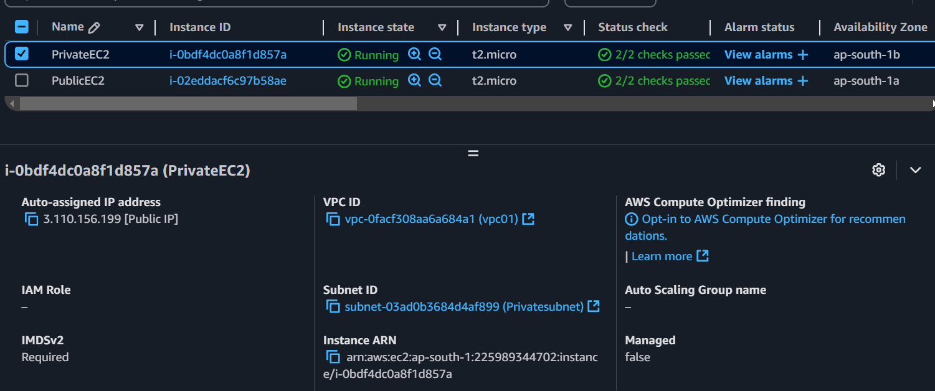
Verify EC2 Configurations
Open EC2 Resource and check the PrivateEC2 is connected to the created vpc01 and Publicsubnet.

Slide 22
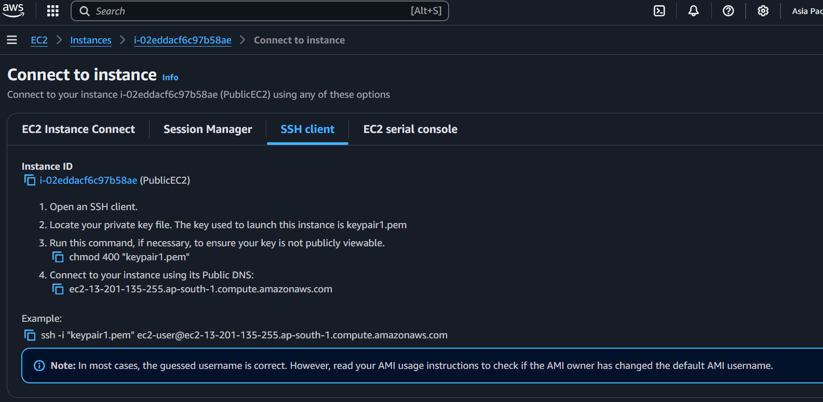
Connecting EC2
Copy the ssh pem link and connect the PublicEC2 to the Gitbash.

Slide 23
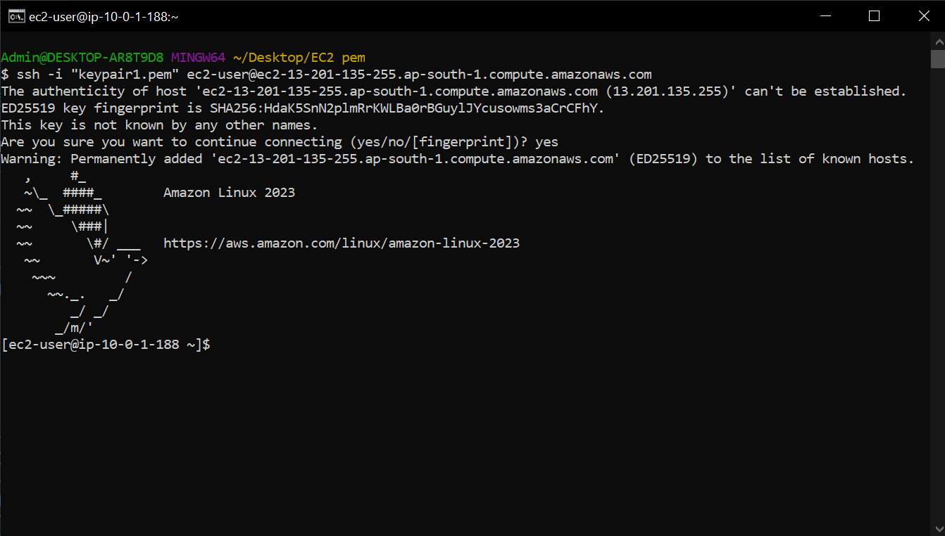
As per we see that Public instance can communicate because the internet gateway is attached to the public subnet.

Slide 24
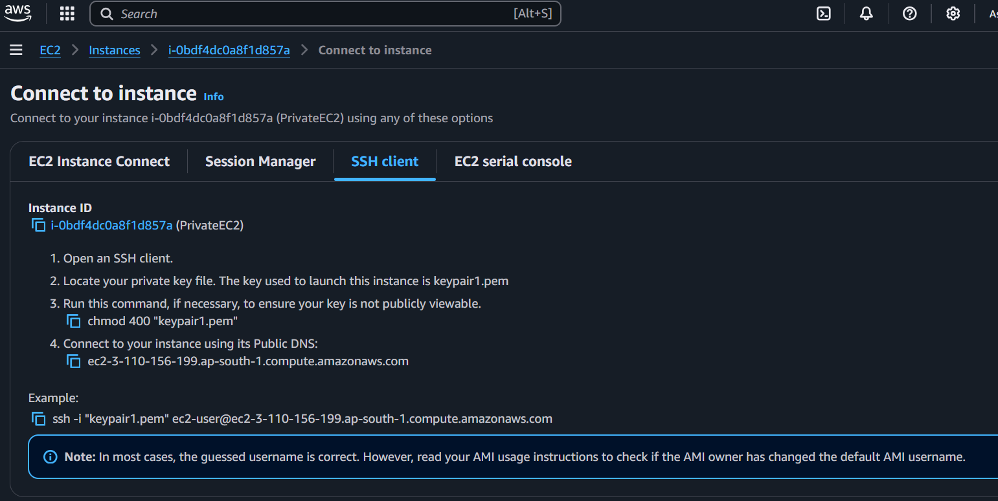
Copy the ssh pem link and connect the PrivateEC2 to the Gitbash.

Slide 25
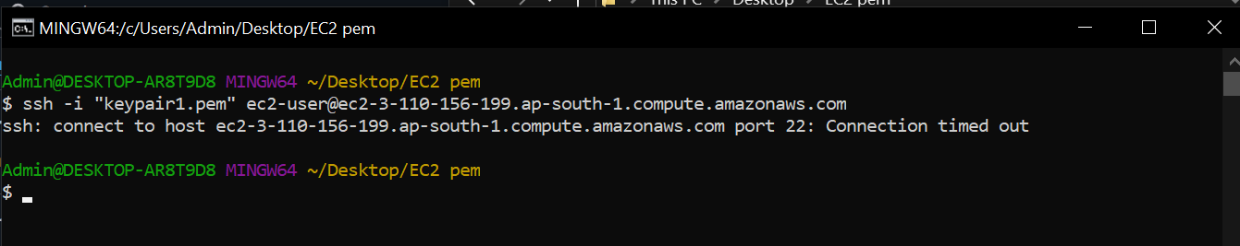
As per we see that Private instance cannot communicate because the internet gateway is not attached to the private subnet.

Slide 26
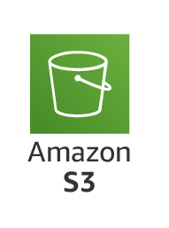
Simple Storage Service:
An S3 bucket is a storage container in Amazon Web Services (AWS) Simple Storage Service (S3). It is used to store and organize data objects (files like images, videos, documents, backups, etc.) in the cloud. Each S3 bucket can hold an unlimited amount of data and is highly scalable, durable, and secure.

Slide 27
S3 Bucket policy:
A Bucket policy in Amazon S3 (Simple Storage Service) is a JSON document that defines the permissions (who can access and what actions they can perform) for the objects within an S3 bucket. It allows you to control access to your S3 bucket at a global level, i.e., it applies to the entire bucket and all of its objects, rather than being set on individual objects or users.
In the bucket policy we can give the public access and private access to the IAM user to access s3 bucket as the permission given in the policy.

Slide 28
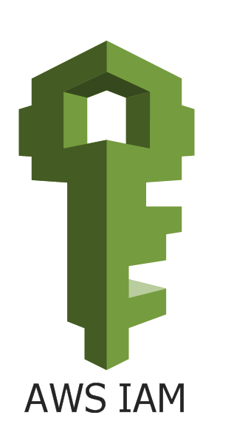
Identity and Access Management (IAM)
IAM (Identity and Access Management) in AWS is a service that helps you securely control access to AWS services and resources for your users, applications, and services. IAM allows you to define who can do what in your AWS environment by managing user identities, permissions, and policies.
IAM is like a security system for your AWS account. It ensures that only authorized users or applications can access and perform actions on AWS resources like EC2 instances, S3 buckets, and databases.
Users:
IAM users are individual identities within your AWS account. Each user can have unique permissions to access specific resources or services.
Example: A user could be an employee, application, or service that needs to access AWS.

Slide 29
Code Description and Explanation
This Terraform code is designed to provision resources in AWS using the ap-south-1 (Mumbai) region. It includes S3 (Simple Storage Service) configurations with Bucket Policy.
provider "aws" {
region = "ap-south-1"
}
resource "aws_s3_bucket" "first_bucket" {
bucket = "s3-bucket-2025"
tags = {
Environment = "prob"
}
}
resource "aws_s3_bucket_public_access_block" "pab" {
bucket = aws_s3_bucket.first_bucket.id
block_public_acls = false
block_public_policy = false
ignore_public_acls = false
restrict_public_buckets = false
}
1. AWS Provider Configuration
Configures the AWS provider for the ap-south-1 region (Mumbai).
2. Create S3 Bucket, Public Access Block, Versioning and Upload Object.
Create S3 Bucket with unique name s3-bucket-2025.
Create Public Access Block and Unblock the Public Access.

Slide 30
Create S3 Bucket Versioning and Enable the Version.
Create an Object in the Bucket and Upload a file in the Object.
resource "aws_s3_bucket_versioning" "first_version" {
bucket = aws_s3_bucket.first_bucket.id
versioning_configuration {
status = "Enabled"
}
}
resource "aws_s3_object" "first_object"{
bucket = aws_s3_bucket.first_bucket.id
key = "myfile.txt"
source = "C:/Users/Admin/Desktop/New/Task/myfile.txt"
}
resource "aws_s3_bucket_policy" "first_policy" {
bucket = aws_s3_bucket.first_bucket.id
policy = jsonencode({
"Version" : "2012-10-17",
"Statement" : [
{
"Effect" : "Allow",
"Action" : ["s3:GetObject"],
"Resource" : "${aws_s3_bucket.first_bucket.arn}/*",
"Principal" : "*",
},
{
"Effect" : "Deny",
"Action" : ["s3:PutObject"],
"Resource" : "${aws_s3_bucket.first_bucket.arn}/*",
"Principal" : "*",
},
Create a Bucket Policy and Generate the policy by using jsonencode.
Give the Actions to the Policy to Allow permission to GetObject.
Give the Actions to the Policy to Deny permission to PutObject.

Slide 31
{
"Effect" : "Deny",
"Action" : ["s3:DeleteObject"],
"Resource" : "${aws_s3_bucket.first_bucket.arn}/*",
"Principal" : "*",
},
{
"Effect" : "Deny",
"Action" : ["s3:DeleteObjectVersion"],
"Resource" : "${aws_s3_bucket.first_bucket.arn}/*",
"Principal" : "*",
}
]
})
}
Give the Actions to the Policy to Deny permission to DeleteObject.
Give the Actions to the Policy to Deny permission to DeleteObjectVersioning.

Slide 32
Permissions:
s3:GetObject:
This permission allows users or services to download or read objects from an S3 bucket.
s3:PutObject:
This permission allows users or services to upload or add objects to an S3 bucket.
s3:DeleteObject:
This permission allows users or services to delete objects from an S3 bucket.
s3:DeleteObjectVersioning:
This permission allows users or services to delete specific versions of an object when versioning is enabled in the S3 bucket.

Slide 33
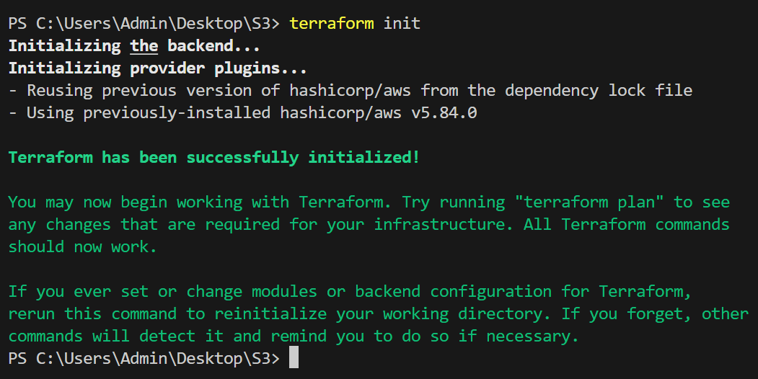
Steps to Initialize, Plan and Apply Terraform
Initialize Terraform:
Run terraform init to:
Run terraform init to Download and configure the necessary provider plugins.
Prepare the working directory for Terraform usage.
Ensure the backend configuration (if defined) is initialized.

Slide 34
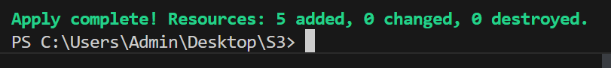
Plan Terraform Execution:
After terraform init, we use terraform plan to check the preview changes that made in infrastructure.
Ensure the configurations are correct before applying changes.​
Apply Terraform Configuration​
Execute terraform apply to:​
Provision and configure resources as defined in your Terraform files.​
Review and confirm the changes if prompted.​

Slide 35
Verification steps in AWS Management Consol
Open the AWS Console and open the S3 Console for verification.

Slide 36
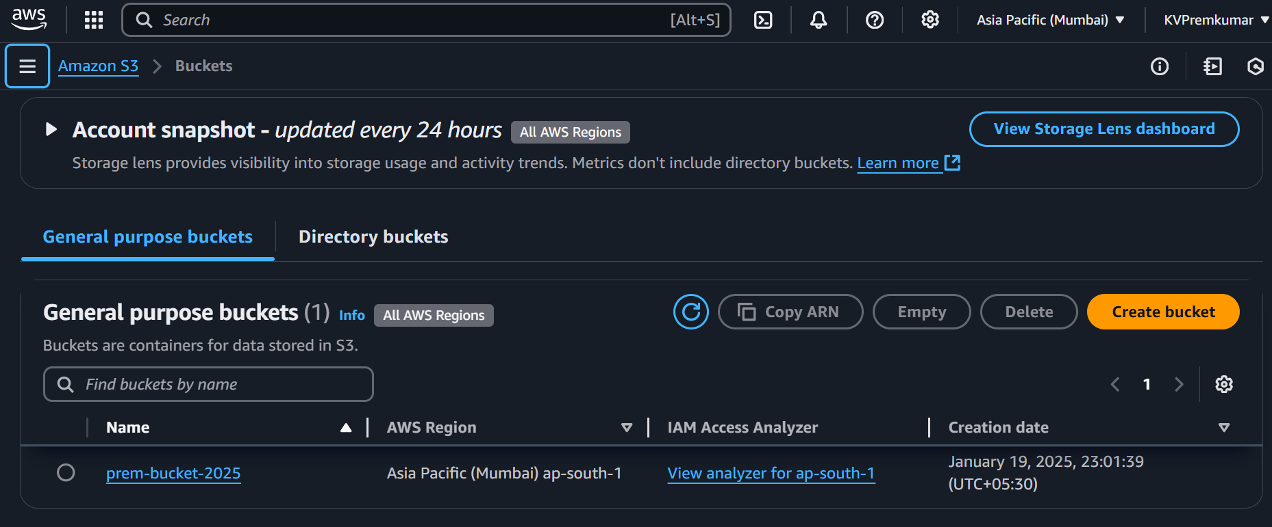
Verify S3 Configurations
Open S3 Resource and check the bucket prem-bucket-2025 is created​.
Click on the Bucket Name to check the Object.

Slide 37
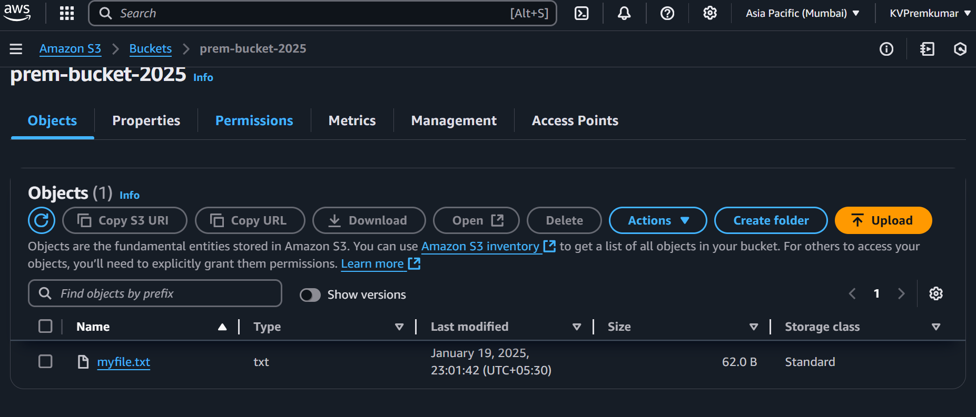
Verify S3 Object
Open Bucket and check the object that myfile.txt is uploaded.
Click on Permissions to check the Bucket Policy.

Slide 38
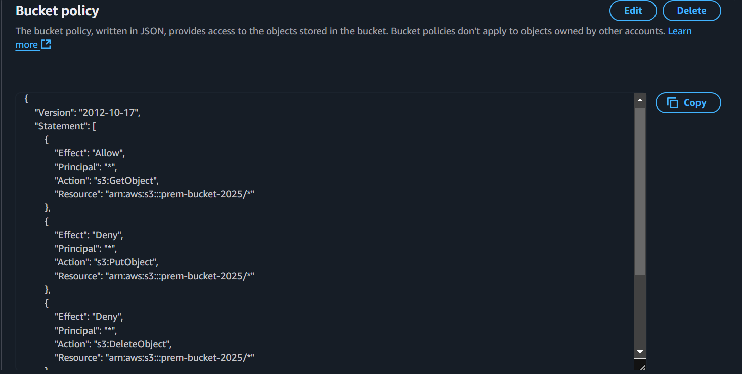
Verify Bucket Policy
After click on the Permission and check the Bucket policy is created as per in the Terraform given.
Click on Permissions to check the Bucket Policy.

Slide 39
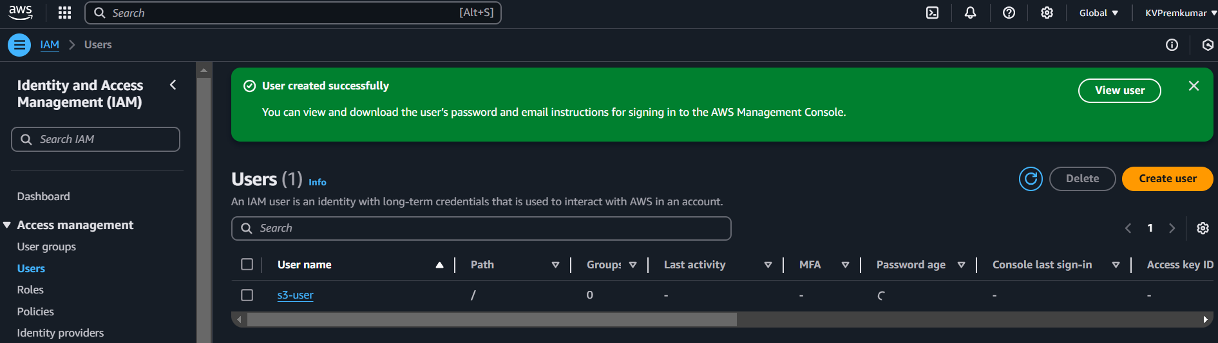
Create IAM user
Open the IAM Console and click on Users.
After click on Create User.
Give the User name s3-user and give the S3 Full Access to the user.
Copy the Credentials of the user and Click on Create User.
The IAM user is created as shown below.

Slide 40
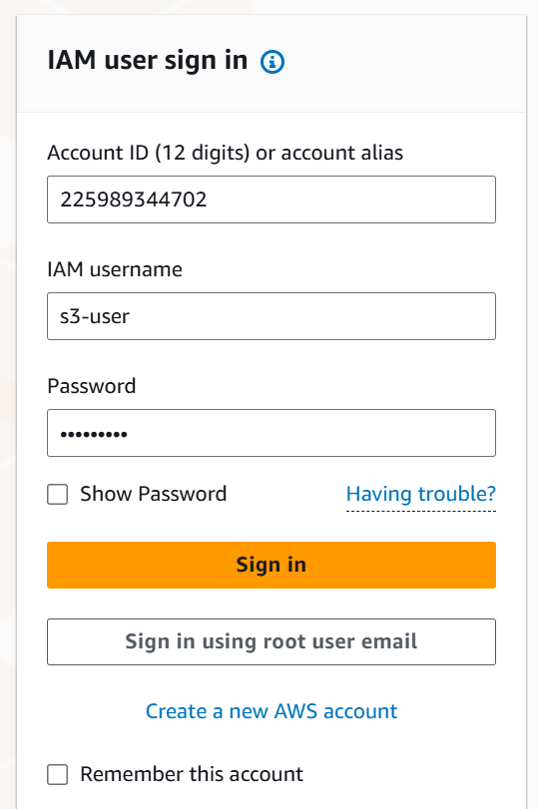
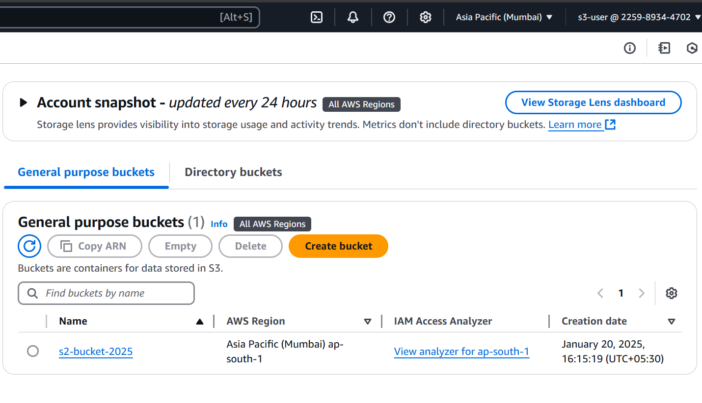
Verify the S3 Public access in IAM User
Open the IAM User account in new tab, as per given when creating the user.
Open the S3 Console in the user account and open the bucket.
After check the uploaded file is getting Open.

Slide 41
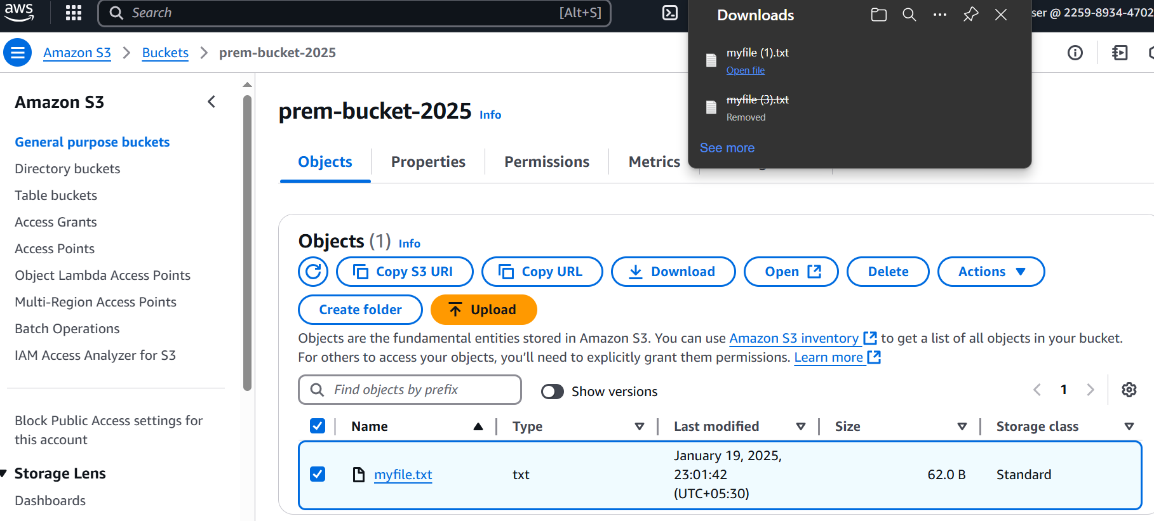
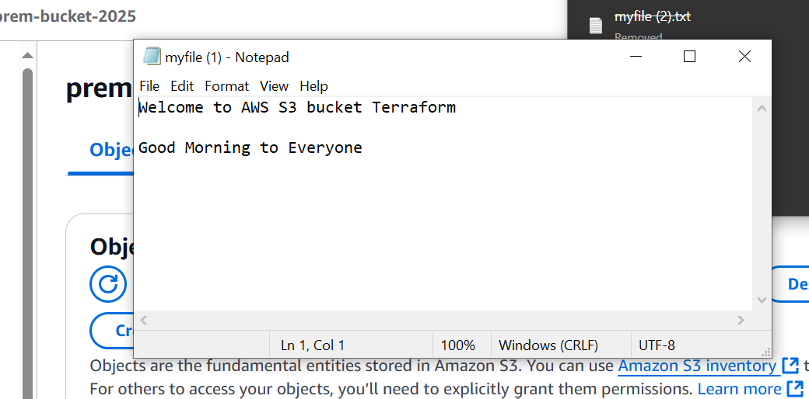
Verify the S3 Public access and Private access in IAM User
Open the IAM User account in new tab, as per given when creating the user.
Open the S3 Console in the user account and open the bucket.
After opening the bucket, select the object and click on open.
The file will download to open.
Click on the downloaded file to open and the data is shown in the file due to Allow permission given in the Policy for GetObject.

Slide 42
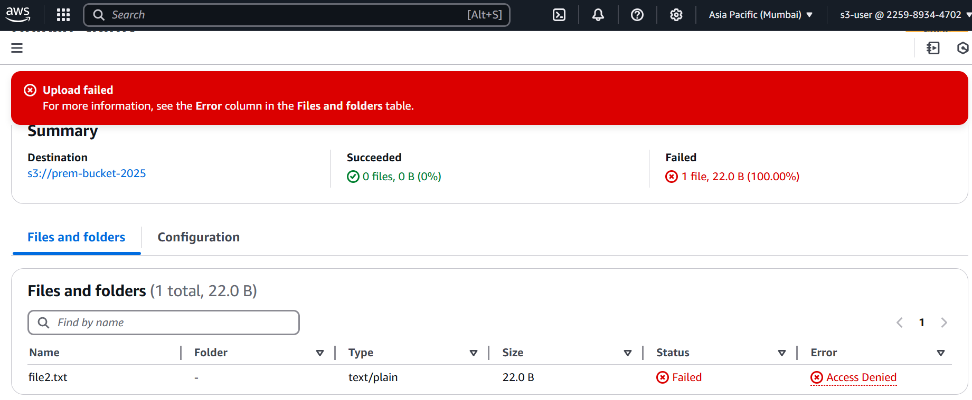
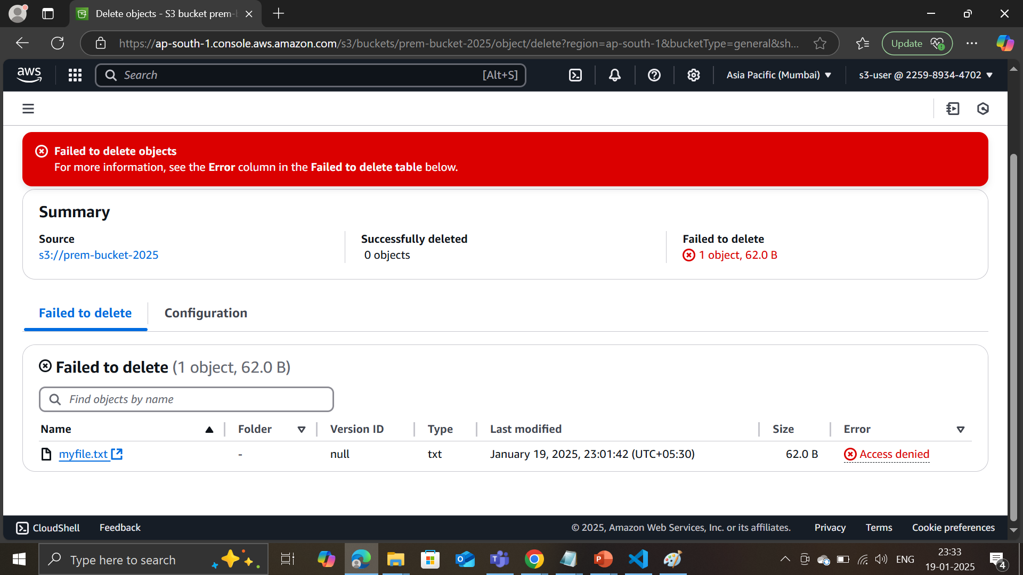
Verify the S3 Private access in IAM User
Try to upload the file in objects, the uploading is failed due to Deny permission given in the Policy for PutObject
Try to delete the file in objects, the deletion is failed due to Deny permission given in the Policy for DeleteObject

Slide 43
Conclusion
This documentation outlines the end-to-end process of deploying and verifying AWS resources using Terraform. ​
1. Networking Testing and Validation
Created VPC with Public and Private Subnets with Internet Gateway Communication using Terraform.
2. Compute Testing and Validation
Verified the Internet Gateway Communication with Public and Private Instance.
3. Storage Testing and Validation
Created S3 Bucket with Public and Private Access in Bucket Policy using Terraform.
Verified the Public and Private Access of S3 Bucket in IAM User.

